Slide 1
New Approach to Teammate Evaluation
Rationale #8
Week 9

Slide 2
Teammate Review Issue …
Average teammate review score from the past 3 semesters
  Spring 2016 96.2%
  Fall 2015 97.9%
  Spring 2015 97.0%
Notes:
Corollary: When you learn something new, mix it up with something old.
Corollary: Tests should all be cumulative.

Slide 3
Teammate Review Issue …
And the median teammate review score?
  Avg. Median
  Spring 2016 96.2% 99.0%
  Fall 2015 97.9% 99.0%
  Spring 2015 97.0% 99.0%
So … team contributions don’t count!
Notes:
Corollary: When you learn something new, mix it up with something old.
Corollary: Tests should all be cumulative.

Slide 4
Ideas for new rubric
More quantitative data
Automatically collected data

Slide 5
New rubric
Question Score Range
How many times was this person late to meetings? (9~10) 0 to 5 (0~1)
How many times did this person not show up? (9~10) 0 to 5 (0~1)
How much did this person offer to do on this project? (20%-0%) 0 to 5 (100%-80%)
What fraction of the work assigned to this person did (s)he do?
(20%-0%) 0 to 5 (100%-80%)
Did this person do assigned work on time? (never) 0 to 5 (always)
How much initiative did this person take on this project?
(total deadbeat) 0 to 5 (a whole lot)
Did this person try to avoid doing any task that was
necessary for completing the project? (absolutely) 0 to 5 (not at all)
How many of the useful ideas for the project did this person provide? (Note: Contribution of all team members should not add up to more than 100%)
(20%-0%) 0 to 5 (100%-80%)

Slide 6
New rubric, cont.
Question Score Range
What fraction of the coding did this person do compared for the project? (Note: Contribution of all team members should not add up to more than 100%)
(20%-0%) 0 to 5 (100%-80%)
What fraction of the documentation did this person write? (Note: Contribution of all team members should not add up to more than 100%)
(20%-0%) 0 to 5 (100%-80%)
How important is this person to the team? (redundant) 0 to 5 (indispensable)

Slide 7
What difference did it make?
And the median teammate review score?
  Avg. Median
  Fall 2016 87.7% 89.0%
  Spring 2016 96.2% 99.0%
  Fall 2015 97.9% 99.0%
  Spring 2015 97.0% 99.0%

Slide 8
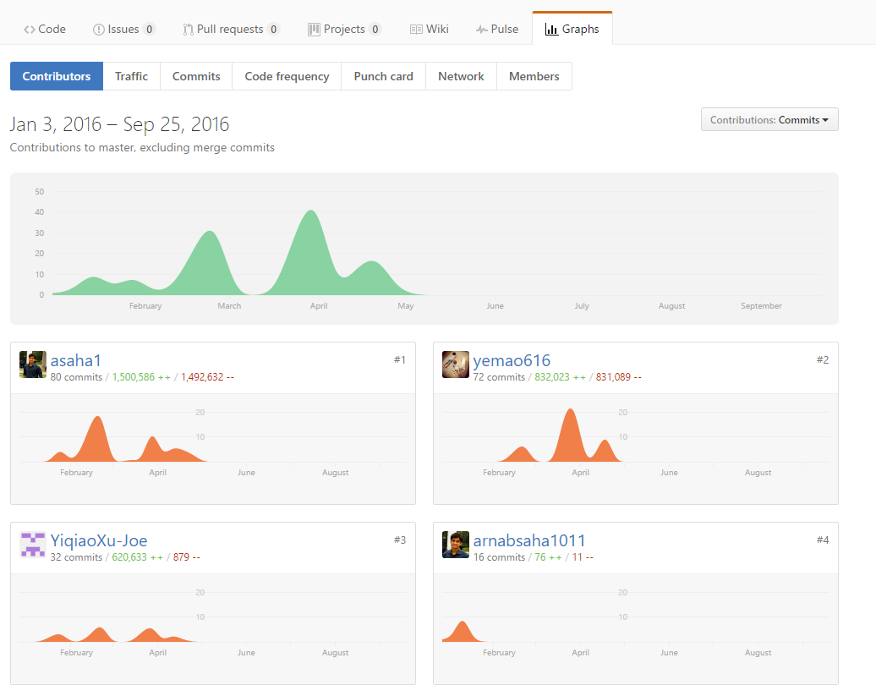

Github metrics
Notes:
We will look at Github metrics in assigning teammate review scores.
We are not sure of the formula yet, and we will solicit advice on which metrics should be considered and why.

